Slide 1
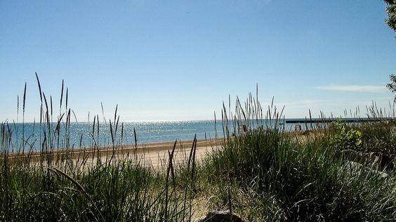
Climate Action Plan and Electricity Aggregation Update
Spring 2017
v2.0

Slide 2

Our mission:
Citizens’ Greener Evanston works to make Evanston a more sustainable community
environmentally
economically
socially
and to address climate change by dramatically reducing our greenhouse gas emissions.

Slide 3
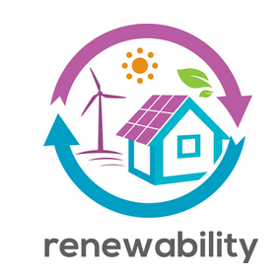
Climate Action and Community Aggregation:
Key Points
Climate change affects everyone: our kids, our health, our food, our community.
The City of Evanston has been committed to reducing our carbon footprint since 2006.
Community Electricity Aggregation with 100% renewable energy is essential to meeting our climate goals.
Electricity aggregation has saved us money over time.
It’s easily to opt out.

Slide 4
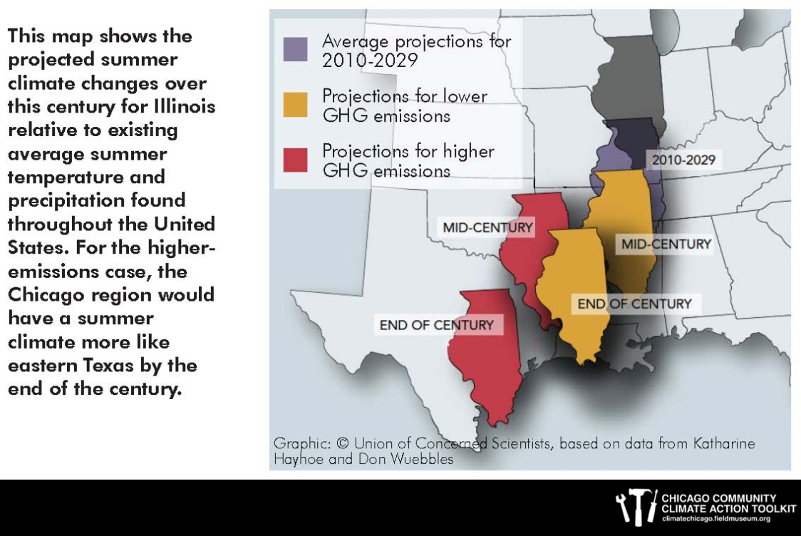
What is Climate Change?
Shifts in weather patterns over long periods of time: temperature, precipitation (rain/snowfall), humidity, wind and ocean circulation.
Courtesy of The Field Museum, Chicago Community Climate Action Toolkit, 2012: climatechicago.fieldmuseum.org

Slide 5
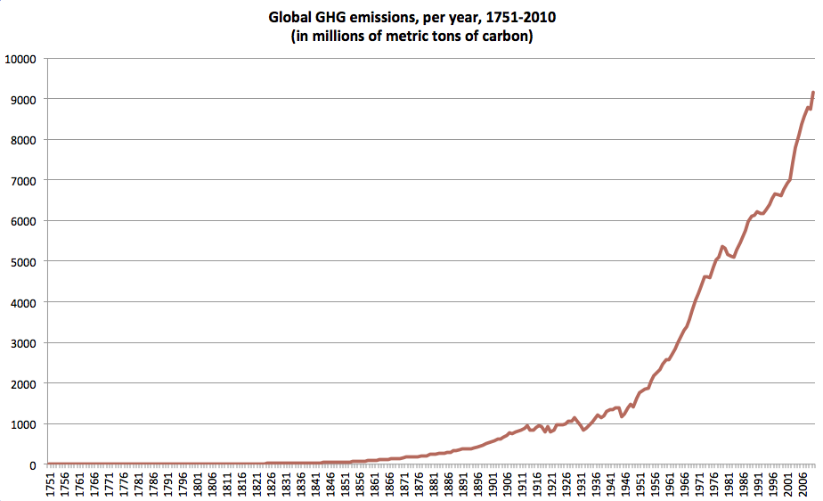
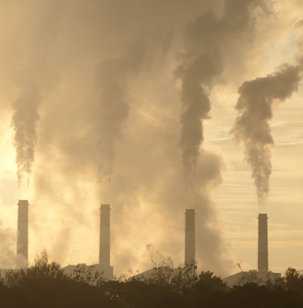
What Causes Climate Change?
Climate change is caused in large part by human activity, primarily burning fossil fuels (coal, petroleum, and natural gas).
We burn fossil fuels when we do things like drive, heat our homes, dispose of waste, process food, and use electricity.
Burning fossil fuels produces greenhouse gases (GHGs), the most significant being carbon dioxide (CO₂). GHGs trap heat in the Earth’s lower atmosphere.
https://cleantechnica.com
http://www.easterbrook.ca

Slide 6
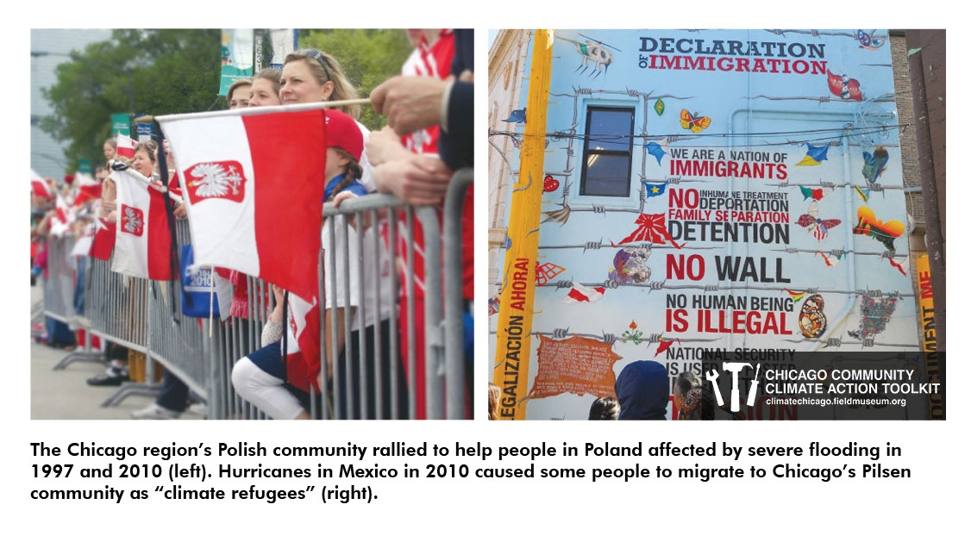
How does climate change affect us?
Temperatures are up 2.6°since 1980 with more increases to come.
The Great Lakes evaporate more during warm winters.
More extreme weather events: heat waves, drought, flooding, blizzards, many more 100°summer days.
Agriculture and fisheries significantly impacted. Variety and supply of food will change.
Population surge around the Great Lakes due to abundant fresh water supply.
More climate refugees in the Chicago area.
Courtesy of The Field Museum, Chicago Community Climate Action Toolkit, 2012: climatechicago.fieldmuseum.org

Slide 7
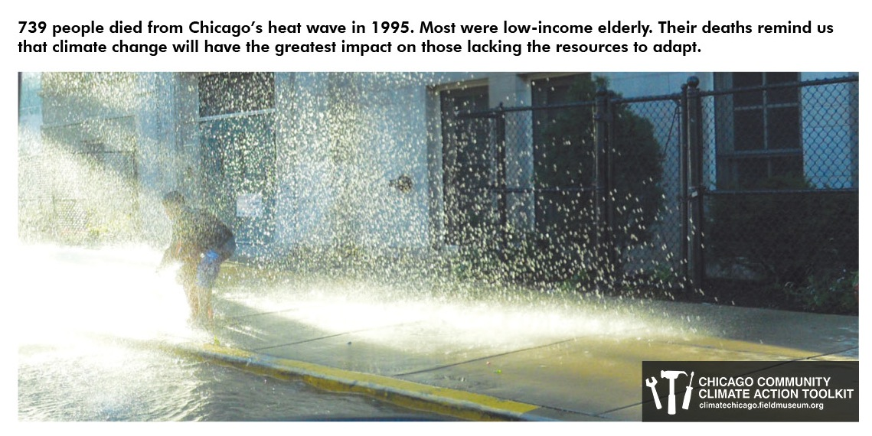
Effect of climate change on people
Scientists project increases in …
Heat–related diseases: heart attacks and asthma
Flooding an droughts
Population around the Great Lakes
Electricity shortages
Government expenses (e.g., road maintenance, emergency response)
Courtesy of The Field Museum, Chicago Community Climate Action Toolkit, 2012: climatechicago.fieldmuseum.org

Slide 8

Climate Change and Health
7 Minute Video (https://youtu.be/AdRNm7vvIFc)

Slide 9
Climate Action Update

Slide 10
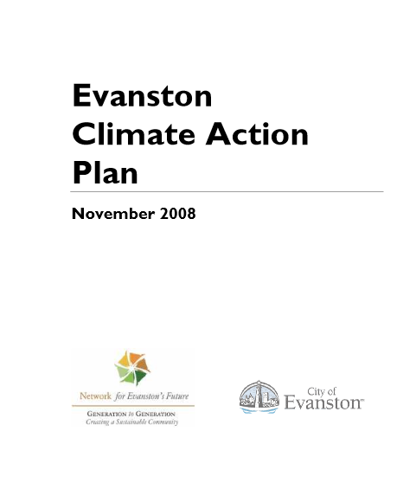

2008
2014
Goal: 13% CO₂ reduction by 2012
PASSED UNANIMOUSLY
ACHIEVED!
Goal: 20% CO₂ reduction by 2016
PASSED UNANIMOUSLY
ACHIEVED?

Slide 11
Emissions Reduction Progress Report
 |  | 2005 (baseline) | 2013 |  |  | 2015
 |  | Emissions | Emissions | Change from 2005 |  | Emissions | Change from 2005
 |  | MTCO2E | MTCO2E | MTC02E | % | MTCO2E | MTC02E | %
City of Evanston | Electricity | 17,588 | 9,805 | -7,783 | -44% | - | -17,588 | -100%
 | Natural Gas | 3,975 | 3,063 | -912 | -23% | 2,995 | -980 | -25%
 | Gasoline | 1,321 | 1,239 | -82 | -6% | 1,086 | -235 | -18%
 | Diesel | 1,398 | 338 | -1,060 | -76% | 603 | -795 | -57%
 | Biodiesel | 278 | 1,325 | 1,047 | 377% | 946 | 668 | 240%
 | TOTAL CITY | 24,560 | 15,770 | -8,790 | -36% | 5,630 | -18,930 | -77%
Community | Electricity-Residential | 154,524 | 49,547 | -104,977 | -68% | 45,832 | -108,692 | -70%
 | Electricity-Commercial | 366,025 | 306,947 | -59,078 | -16% | 258,764 | -107,261 | -29%
 | Electricity-Rail | 18,785 | 22,085 | 3,300 | 18% | 13,396 | -5,389 | -29%
 | Natural Gas-Residential | 114,674 | 122,458 | 7,784 | 7% | 118,433 | 3,759 | 3%
 | Natural Gas-Commercial | 224,266 | 221,533 | -2,733 | -1% | 217,779 | -6,487 | -3%
 | Gasoline | 99,664 | 113,014 | 13,350 | 13% | 141,773 | 42,109 | 42%
 | Diesel | 25,869 | 28,253 | 2,384 | 9% | 35,443 | 9,574 | 37%
 | TOTAL COMMUNITY | 1,003,807 | 863,837 | -139,970 | -14% | 831,420 | -172,387 | -17%
COMBINED TOTAL |  | 1,028,367 | 879,607 | -148,760 | -14.5% | 837,050 | -191,317 | -18.6%
Biggest reduction is in residential electricity, which comes from aggregation with 100% renewable energy.

Slide 13

Continuing aggregation
with 100% renewable energy
is essential to our climate action goals!

Slide 14
Community Aggregation Update

Slide 15
What is Aggregation?
Community Choice Electricity Aggregation is an opt-out program that allows local governments to bundle together, or aggregate, residential and small commercial electric accounts and seek proposals for a cleaner, and possibly cheaper, energy sources.
By bundling residential and small commercial accounts, municipalities may be able to obtain savings by purchasing energy supply from the open market.
Aggregation is enabled by a referendum.
ComEd still delivers the electricity and remains responsible for customer service, billing and outage response.
Community electricity aggregation allows the city council to choose a supplier for all residential and small commercial customers in order to get a better deal. In Evanston, “better” means cheaper AND greener.

Slide 16
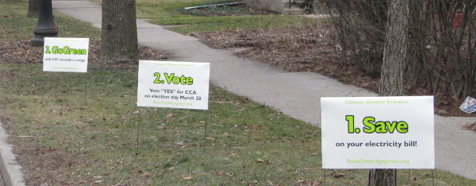
Community Aggregation in Evanston
March 2012: 73% of Evanston voters approved the aggregation referendum.
April 2012: City Council unanimously approved 12-month contract, 100% renewable.
April 2013: City Council unanimously approved 12-month contract, 100% renewable.
April 2014: City Council unanimously approved 36-month contract, 100% renewable.
16

Slide 17
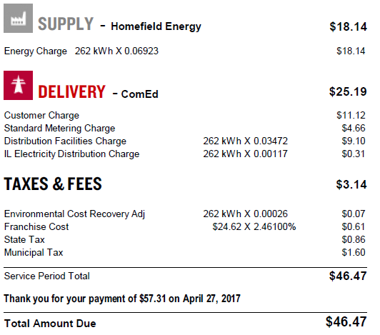
Aggregation on Your Electric Bill
Aggregation applies to the “supply” portion of the bill.
You’re in aggregation if Homefield Energy is listed as the supplier. ComEd passes this portion of your payment through to Homefield.
ComEd gets paid for delivery.

Slide 18
Aggregation Rate History
Year | Supplier | Total Rate with Renewables (cents/kWh) | Renewable Cost Portion (cents/kWh)
2012 | Constellation | 4.797 | 0.107
2013 | Verde | 5.192 | 0.080
2014 | Homefield | 7.644 | 0.098
2015 |  | 7.644 | 0.098
2016 |  | 6.923 | 0.098

Slide 19
Extra Cost of Renewable Energy
2012: 0.107 ¢/kWh x 9000 kWh/year = $9.63 per year
2013: 0.080 ¢/kWh x 9000 kWh/year = $7.20 per year
2014-2017 0.098 ¢/kWh x 9000 kWh/year = $8.82 per year
Total cost to community assuming 30,000 households:
2012: $288,900
2013: $216,000
2014-2017: $264,600
A conservative estimate for a typical single family home.
Going 100% renewable is cheap—less than a $10 a year!

Slide 20
Aggregation vs Com Ed
12 month contract:
Constellation
12 month contract:
Verde
36 month contract:
Homefield

Slide 21
Aggregation vs Com Ed
Beware of aggressive and predatory marketers!
Current price difference:
0.605 cents/kWh
($54/year for 9000 kWh)
Negligible difference between base and 100% renewable.

Slide 22
Actual Savings with Aggregation
Year | 2013 | 2014 | 2015 | 2106
kWh | 6,183 | 7,636 | 5,836 | 5,445

Slide 23
Actual Savings with Aggregation
Aggregation has saved us money over time!
($154 in this case.)

Slide 24
Aggregation Summary
KEY POINTS
Aggregation with renewables is essential to meeting our climate goals.
Aggregation with renewables has saved us money over time.
It’s easy to opt out.
ADDITIONAL BENEFITS
Transparent, reliable pricing—rate is known for 1-3 years (unlike ComEd).
Community pride as a nationally recognized climate leader.
STAR Community points.

Slide 25
The Request: Continue Aggregation!
We don’t yet know what the aggregation rate will be for the next contract.
  We’ll have an idea by May 29.
  We’ll know for sure on June 26.
If aggregation is more expensive it won’t be by much.
  And over time ComEd’s cost may increase.
Continue aggregation even if it does cost more!
  Individuals can easily opt out if it costs too much.

Slide 26
2017 Aggregation Timeline
RFP issued April 24, 2017
Last Day to submit questions May 8, 2017
Final Addendum Issued May 15, 2017
RFP Submission Due Date May 29, 2017
Short list to Receive Bid for Actionable Pricing June 15, 2017
Actionable Pricing Received/Council Vote June 26, 2017

Slide 27
How you can help:
Sign the on-line petition and request a yard sign
  http://greenerevanston.org/events/evanston-friends-electricity-aggregation
For more information…
Jonathan Nieuwsma, CGE President
president@greenerevanston.org
773-255-0716
City of Evanston Aggregation Info
https://www.cityofevanston.org/about-evanston/sustainability/community-choice-electricity-aggregation
Illinois Aggregation Info
https://www.pluginillinois.org/MunicipalAggregation.aspx

Slide 28
Backup

Slide 29
100% Renewable Cities
The following mayors have pledged their support for a community-wide transition to 100% renewable energy:
Mayor Eric Garcetti, Los Angeles, CA
Mayor Suzanne Jones, Boulder, CO*
Mayor Greg Lemons, Abita Springs, LA*
Mayor Sam Liccardo, San Jose, CA*
Mayor Mark Meadows, East Lansing, MI
Mayor Greg Scharff, Palo Alto, CA*
Mayor Helene Schneider, Santa Barbara, CA
Mayor Steve Skadron, Aspen, CO*
Deputy-Mayor D. Dwight Worden, Del Mar, CA*
Mayor Ardell Brede, Rochester, MN*
Mayor Rick Krisman, St. Petersburg, FL*
Mayor Bob Dixson, Greensburg, KS
Mayor Rosalynn Bliss, Grand Rapids, MI*
Mayor Drew Fixell, Tarrytown, NY
Mayor Christopher Taylor, Ann Arbor, MI
Mayor Phillip D. Kramer, Franklin Township, NJ
Mayor Ethan K. Strimling, Portland, ME
Mayor Cary Glickstein, Delray Beach, FL
Mayor Tom Butt, Richmond, CA
Mayor John Engen Missoula, MT
Mayor Frank Bivona, Franklin Lakes, NJ
Mayor Philip K. Stoddard, South Miami, FL
Mayor Miro Weinberger, Burlington, VT*
Mayor David Mejia, Alhambra, CA
Mayor John A Ostenburg, Park Forest, IL
Mayor JoAnn B Seghini, Midvale City, UT
Mayor Peter Rustin, Tenafly, NJ
Mayor Skylar Peak, Malibu, CA
Mayor Dave Coulter, Ferndale, MI
Mayor Nicola Smith, Lynnwood, WA
Mayor Shelley Welsch, University City, MO
Mayor Jordan Norley, Borough of West Chester, PA
Mayor Mary Prochnow, Los Altos, CA
Mayor Lydia E Lavelle, Carrboro, NC
Mayor Eugene Flinn, Palmetto Bay, FL
Mayor Emmett V Jordan, Greenbelt, MD
Mayor Lioneld Jordan, Fayetteville, AR
Mayor Heidi Harmon San Luis Obispo, CA
Mayor David S Cassetti, Ansonia, CT
Mayor Val Tollefson, Bainbridge Island, WA
Mayor Annette M Blackwell, Maple Heights, OH
Source: http://www.sierraclub.org/ready-for-100/mayors-for-clean-energy

Slide 30
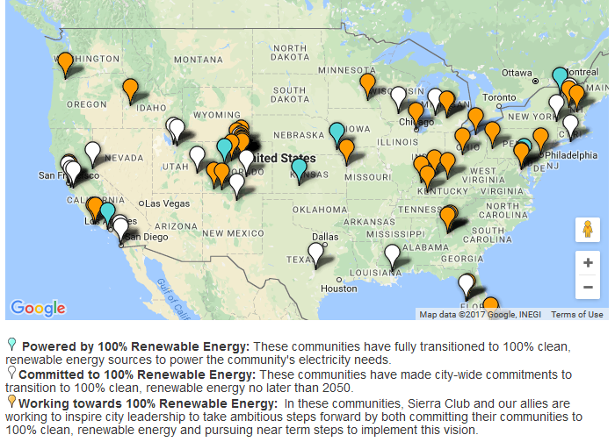
100% Renewable Cities
Source: http://www.sierraclub.org/ready-for-100

Slide 31
Aggregation in Illinois
Median: 6.722
Mean: 6.730
Evanston: 6.923 cents/kWh
communities have passed referendums
716 communities have aggregated
591 communities are still aggregating (259 in ComEd)

Slide 32
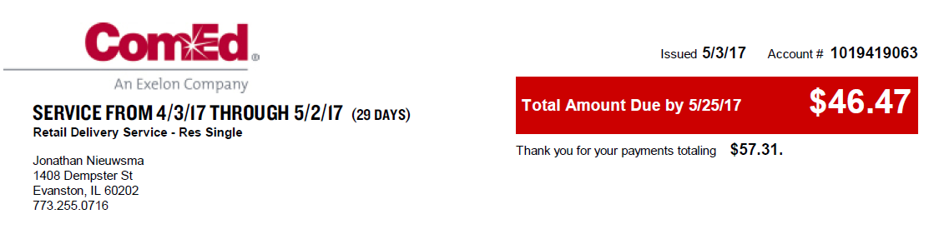
How to Opt Out (Current Supplier)
Step 1. Find an electric bill.
Note: customer name
account address
account number
Step 2. Contact Homefield and request to opt out
866-694-1262
custcare@homefieldenergy.com
32

